Slide 1


Capacity building experience on open-source real time payment systems in Tanzania
System integrator perspective
25 April 2022

Slide 2
Agenda
Introduction to UNCDF & our work
Project achievements & learnings
Panel discussion: System integrator perspective
Presenting the industry position paper
Q & A

Slide 3
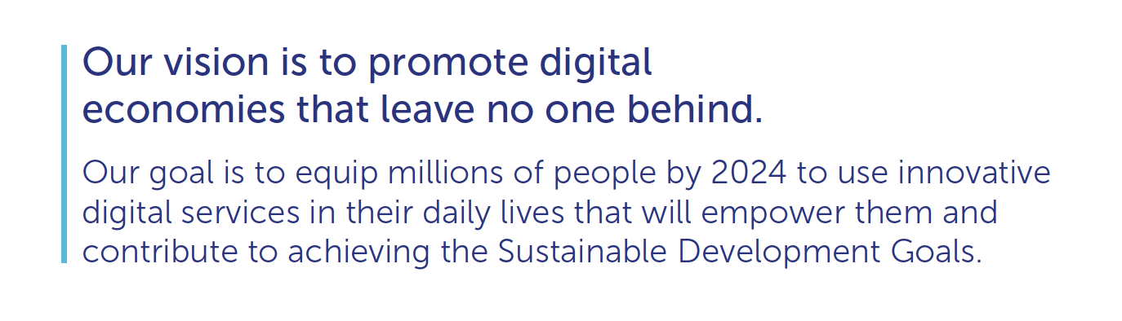
UNCDF
Inclusive Digital Economies: Market Development Approach

Slide 4




UNCDF Workstreams: Building Blocks for a Digital Economy
Policy & Regulation
Open Digital Payment Ecosystem
Working with governments to develop policies that support and provide an enabling environment for digital payments and services
Understanding the importance of digital payments as the basis for sustainable, economically impactful digital service
Skills
Inclusive Innovation
Helping users acquire the necessary skills (digital and financial) to adopt new digital services
Supporting entrepreneurs and MSMEs to build inclusive digital services that improve local livelihoods

Slide 5
Project achievements, learnings

Slide 6
Why the project
A national OSS will drive;
Cheaper & more diverse digital products
Easier for payments to happen across different DFSPs
Smaller DFSPs more likely to roll out digital products in rural areas & reaching more women
Notes:
An open source payment system is a …….

Slide 7
Project results
Deployed a sandbox for training on the interoperable payments technology component
21 financial services providers (MFIs and SACCOs) engaged
2 system integrators fully integrated & supported to play the role of local capacity builders
11 DFSPs fully integrated
6 DFSPs joined a Multi-tenant solution
Other support
Trainings on digital payments:
Open source, real-time payment systems
Business models
Use cases
Policy & advocacy
Training
Use of local capacity builders
Institutional strengthening of apex orgs & Evidence based advocacy
Creation of a sandbox/lab environment to fast-track learning

Slide 8
Project learnings
TECHNICAL
BUSINESS
BUSINESS
Changed the PM4ML to a single instance rather than for each DFSP level
Customised support geared towards Tier II and III DFSPs
Investments in and around digitization as a foundational element
Digitization makes both business & compliance sense (MFI Act 2018)

Slide 9
Challenges encountered
Lack of stable internet negatively affected participation in online trainings
100% virtual delivery of technical backstopping (due to covid) delayed pace of project implementation
Inability or lack of prioritization of some participating DFSPs to cover vendor related costs around API integrations
Important issues to note
Project related challenges
BoT priority currently focused on Tier I DFSPs. This would affect integration support for Tier II and III DFSPs.
Current limited options for the smaller DFSPs to Integrate to TIPS.
Smaller DFSPs face more foundational issues around acquiring core banking solutions.

Slide 10
Panel discussion with system integrators

Slide 11
SI/DFSP’s EXPERIENCES
Challenges
Gains
Recommendations
Convincing DFSPs to be part of the project; no interest, relevance
Manual operations
Limited or lacking access to digital technology
Little or no digital literacy
Limited financial resources
Not comfortable with online/self-learning training
Language barrier
Better understanding of open- source technology,
National switch/TIPS fundamentals
Gained/increased knowledge on digital technology
Firsthand experience on benefits of digital technology; increased operational efficiency (record keeping, reporting (management, statutory, regulatory), improving provision of services to members
Saccos CBS solution,
Well structured Pactical/hands on capacity building
Increased awareness on Microfinance Act
Finance to support the above

Slide 12

TCDC
Management System
TCDC
TCDC Key Function, Roles & Responsibilities
Regulatory Reporting
SACCOS 1
SACCOS with CBS
Connect Ready
SACCOS 2
SACCOS with CBS
Not Connect Ready
SACCOS 3
No
SACCOS CBS
Integration Cost
Maintenance Cost
Internal Support Cost
Minimal Internal Support
SaaS Shared Services (Costs)
Need Support to integrate
SACCOS 2a
SACCOS Management System Can be modified to become Connect Ready
SACCOS 2b
SACCOS Management System Can not be modified to be Connect Ready
Need Support to modify Systems for connectivity
Modification Cost
Integration Cost
Maintenance Cost
Internal Support Cost
Need Support to acquire Systems

Slide 13


DGTOF MULTI TENANT SOLUTION
Merchants
Government
DGTOF-SACCOS
TCDC
Tier 3
Tanzania Instant Payment System
TIPS
Reports
TIPS Connector
Digital Payment Engine
DGTOF-MFI
BOT
BOT
Tier 2
Reports
DGTOF Core Connector
DGTOF-VICO
LGA
Tier 4
Reports
MNOs
S1
S2
S3
S4
Sn
Banks
Shared Services

Slide 14
Supporting evidence based advocacy
The industry position paper

Slide 15
Why the industry position paper
Describes the status of the MFI, SACCO industry and reviews the policies and regulations affecting the various Tiers
Aims to provide a snapshot analysis of the state of the MFI industry in Tanzania
Highlight options to accelerate MFI participation in Tanzania’s wider inclusive digital economy.

Slide 16
Challenges faced by MFIs
Institutional capacity, regulatory and technology limitations

Slide 17
Weak institutional position to drive digitization agenda
Governance structure
Staff turnover, skills & integrity
Portfolio quality
Funding costs

Slide 18
Regulatory limitations are impeding the growth of MFIs
Interest rate cap
MFIs are not a part of payment system
Compliance cost
Innovation approval processes

Slide 19
Technology constraints further limit their growth
Lack of or rudimentary IT systems
Low digital literacy

Slide 20
MFIs digital transformation
A roadmap

Slide 21
Digital transformation is essential for MFIs to remain competitive and better serve their clients
1. Digitize processes
2. Digitize product and business models
3. Digitize channels
4. Digitize engagement with people
Digitizing a number of repetitive and low-risk processes
Digitization for fostering innovation across products
Pillars for MFIs digital transformation
Technology can increase connectivity with customers and employees
Leverage technology to digitize traditional distribution channels

Slide 22
Recommendations
Support on digitization & shared systems
Creation of a sandbox
Evidence based advocacy

Slide 23
THANK YOU!

